Slide 1
Drug Usage Prediction Program
By Robert Liam Miller and Binh Hoang

Slide 2
Overview
The goal of this project is to take existing data about the usage of cocaine and other substances in the United States over time and use it to predict the future rates.

Slide 3
How It Works
Let the user select a csv file to upload from the file directory.
Then, the program lets users select the columns from the file for feature processing, which then gets trained and tested for linear regression, predict and visualize
It also allows them to write the data to a csv file for their purposes whatever it may be.

Slide 4
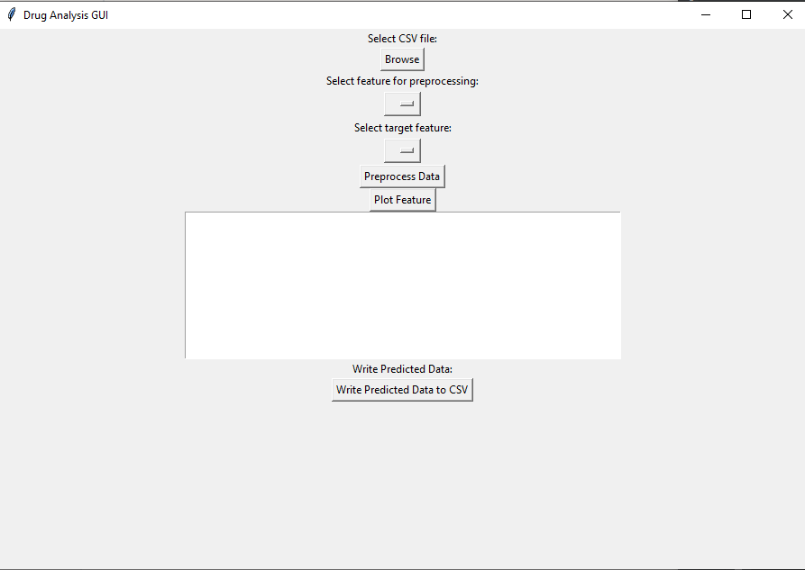

Slide 5
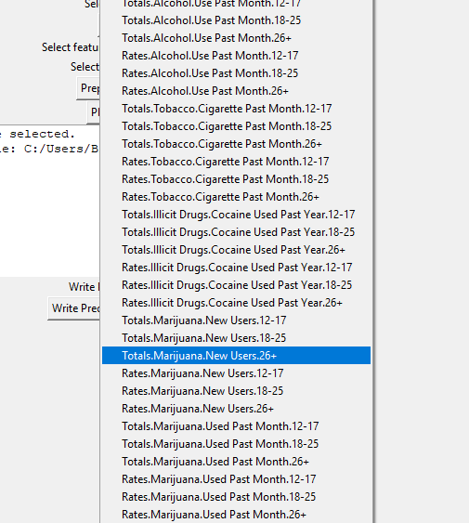
Implementation of Class Features

Slide 6
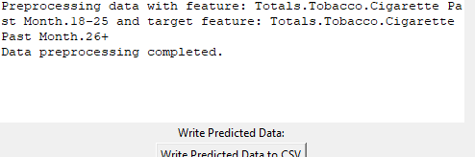
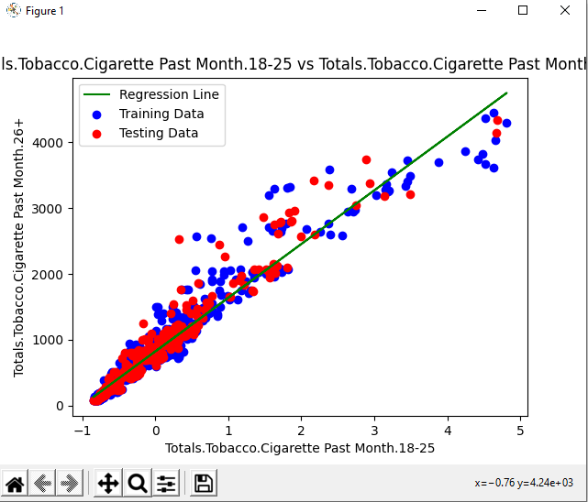

Visualizing the Model

Slide 7
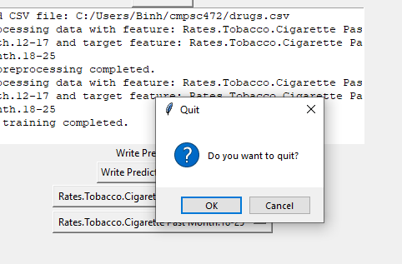
Exit

Slide 8
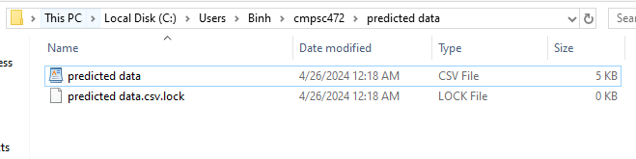
File Lock

Slide 9
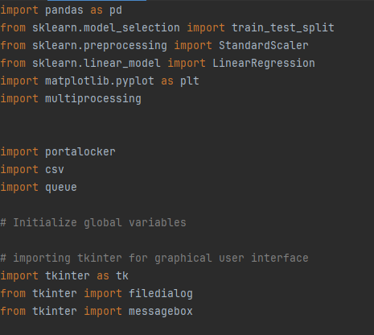
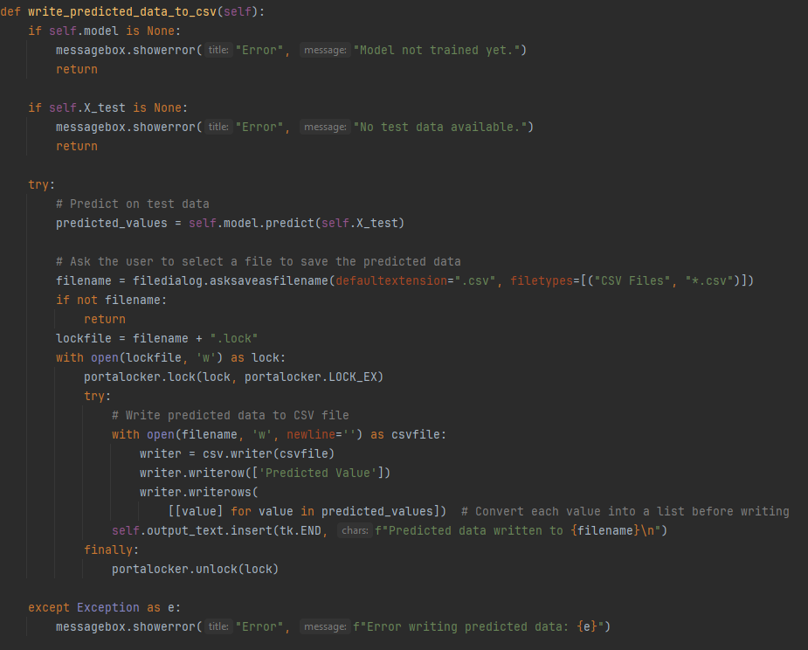
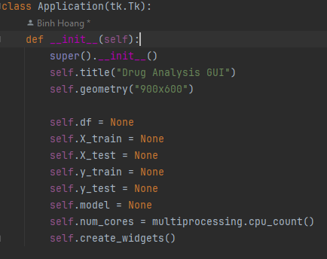
Code Structure

Slide 10
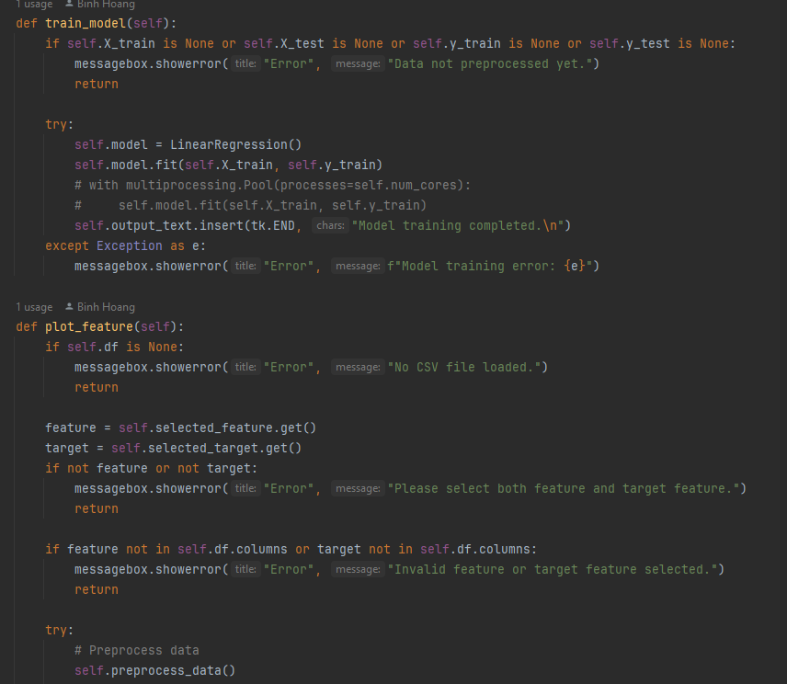
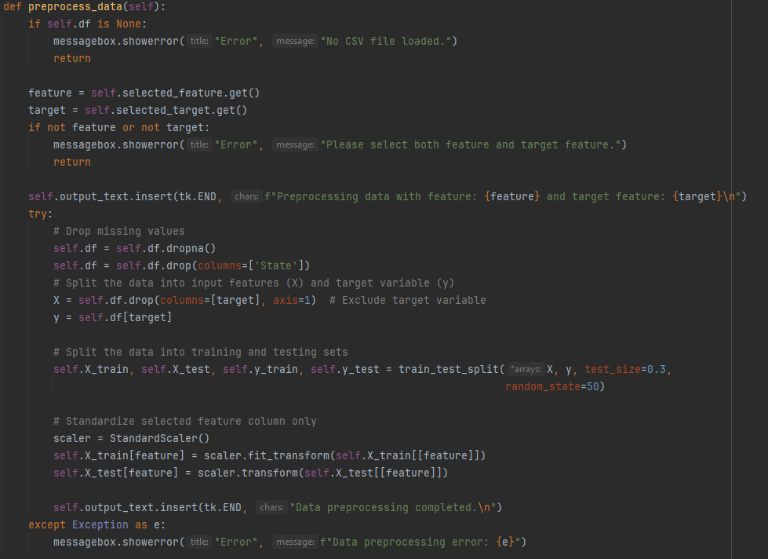

Slide 11

Conclusion
Limitations
Only takes csv format. Would like to expand on the application of different types of formats like xlsx or html
When plotting the data, it will give an error message about columns that can't be processed but will still process and plot data. There is no check for columns of non-numeric data.
Aspirations
Does not connect to a database. If it did, we would grant more capabilities based on user like being able to write to the database on a server.

